Slide 1
Two-Way Feature Extraction for Speech Emotion Recognition Using Deep Learning
Slide: 01
Team #14
Presented by: 23166028 Md. Touhidul Islam
ST/RA: Sadiul Arefin Rafi/ Sania Azhmee Bhuiyan

Slide 2
Introduction
Slide: 02
Speech Emotion Recognition (SER) enables machines to detect and classify emotions in human speech.
Emotions are generally classified by SER, including “happy”, “sad”, “angry” and “neutral”.
SER is essential for adding human elements to machines and improving human-machine communication.
Machine learning and deep learning models are used to train machines in understanding human emotions.
Optimizing SER models offers numerous possibilities for accurate and effective emotion recognition in speech.

Slide 3
Slide: 03
Literature Review
Various studies have achieved accuracy rates ranging from 58.24% to 82.35% in emotion recognition from speech using techniques like Decision Trees, Random Forest Classifiers, and Support Vector Machines. [1][2][3]
CNNs and Deep CNNs have demonstrated maximum accuracy rates of 40.2% to 70.1% when applied to speech emotion recognition. [4][5][6]
LSTM, DNN, and CNN-LSTM hybrids have shown promising results, with accuracies reaching up to 82.35% when utilizing features such as MFCCs and log-mel spectrograms. [7]
Utilizing pre-trained networks like AlexNet, researchers achieved an average accuracy of approximately 80% in their speech emotion recognition system.[8]

Slide 4
Datasets
Slide: 04
For this research work, two datasets have been utilized:
TESS - (Toronto Emotional Speech Set)
2800 data samples
Portrayed : anger, disgust, fear, happiness, pleasant surprise, sadness, and neutral
RAVDESS - (Ryerson Audio-Visual Database of Emotional Speech and Song)
1440 data samples
Portrayed : calm, happy, sad, angry, fearful, surprise, and disgust

Slide 5
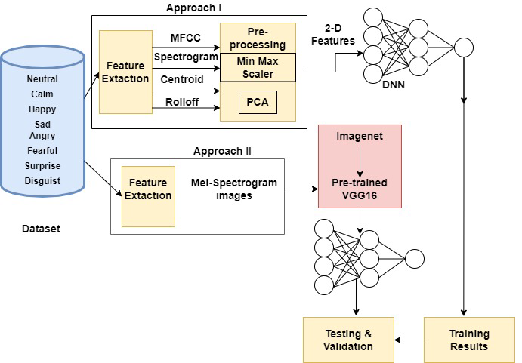
Slide: 05
Proposed Model
Proposed a two-way approach to extract features from the speech dataset.
First Approach:
Feature extraction:
Combination of MFCC, Log Mel-Spectrogram, Chroma, Spectral centroid, and Spectral rolloff
DNN is used along with dropout layers
Second Approach:
Feature Extraction:
Using librosa library, Mel-Spectrogram image has been extracted
Used VGG16’s fastai model

Slide 6
Results
Slide: 06
SERIAL NO. | MODEL | RAVDESS | RAVDESS
1 | Decision Tree | 37.85% | 3.21%
2 | Random Forest | 46.88% | 7.68%
3 | MLPClassifier | 33.68% | 15.54%
4 | ResNet18 | 79.16% | 96.26%
5 | Proposed-I | 73.95% | 99.99%
6 | Proposed-II | 81.94% | 97.15%

Slide 7
Future Work
Slide: 07
Apply the proposed model to additional datasets, expanding its usage beyond the current study.
Extend the study to encompass a wider range of demographic characteristics, beyond the current focus on individuals of median age.

Slide 8
Conclusion
Slide: 08
Proposed models using two-way feature extraction and deep transfer learning outperform existing models in speech emotion recognition.
Extensive experiments and comparative analyses demonstrate the superior performance of the proposed models.
The research highlights the potential of machine learning and deep learning in accurately identifying and processing human emotions via speech.

Slide 9
References
Slide: 09
Kurpukdee, N.; Kasuriya, S.; Chunwijitra, V.; Wutiwiwatchai, C.; Lamsrichan, P. A study of support vector machines for emotional speech recognition. In Proceedings of the 2017 8th International Conference of Information and Communication Technology for Embedded Systems (IC-ICTES), Chonburi, Thailand, 7–9 May 2017; pp. 1–6.
Pandey, S.; Shekhawat, H.; Prasanna, S. Deep Learning Techniques for Speech Emotion Recognition : A Review. In Proceedings of the 2019 29th International Conference Radioelektronika (RADIOELEKTRONIKA), Pardubice, Czech Republic, 16–18 April 2019.
Noroozi, F.; Sapi ´ nski, T.; Kami´ nska, D.; Anbarjafari, G. Vocal-based emotion recognition using random forests and decision tree. Int. J. Speech Technol. 2017, 20, 239–246.
Weiqiao, Z.; Yu, J.; Zou, Y. An experimental study of speech emotion recognition based on deep convolutional neural networks. In Proceedings of the 2015 International Conference on Affective Computing and Intelligent Interaction (ACII), Xi’an, China, 21–24 September 2015; pp. 827–831.
Rezaeipanah, A.; Mojarad, M. Modeling the Scheduling Problem in Cellular Manufacturing Systems Using Genetic Algorithm as an Efficient Meta-Heuristic Approach. J. Artif. Intell. Technol. 2021, 1, 228–234.
Krishnamoorthi, R.; Joshi, S.; Almarzouki, H.Z.; Shukla, P.K.; Rizwan, A.; Kalpana, C.; Tiwari, B. A Novel Diabetes Healthcare Disease Prediction Framework Using Machine Learning Techniques. J. Healthc. Eng. 2022, 2022, 1684017.
Pandey, S.; Shekhawat, H.; Prasanna, S. Deep Learning Techniques for Speech Emotion Recognition : A Review. In Proceedings of the 2019 29th International Conference Radioelektronika (RADIOELEKTRONIKA), Pardubice, Czech Republic, 16–18 April 2019.
Lech, M.; Stolar, M.; Best, C.; Bolia, R. Real-time speech emotion recognition using a pre-trained image classification network: Effects of bandwidth reduction and companding. Front. Comput. Sci. 2020, 2, 14.

